Slide 1
Chapter 6 Simulation Language
Prepared By:
Asst. Prof. Sundar Kunwar
Department of Computer Science and Engineering
Nepal Engineering College

Slide 2
Continuous and Discrete Simulation Language
Simulation languages are divided into 2 types
Discrete
Continuous
Continuous simulation languages are designed for simulating continuous models and discrete simulation languages for discrete models.
A language called a combined simulation language is written for system models in which some of the variables change continuously and other variables change discretely.
Both variables - discrete and continuous interact with each other.
e.g.: No. of passenger in a lift change discretely whereas the lift distance from the ground floor is continuous.

Slide 3
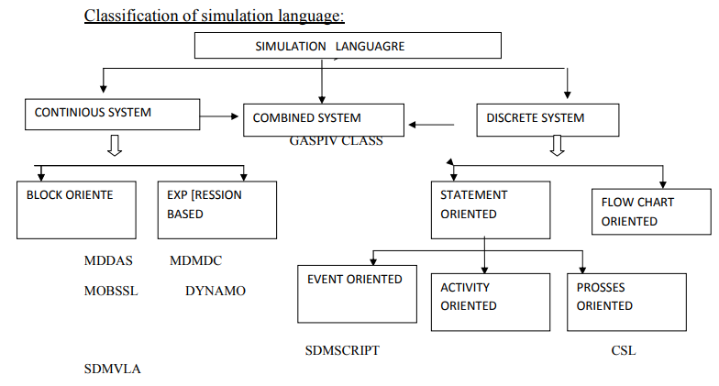

Slide 4
GPSS(General Purpose Simulation System)
GPSS (General Purpose Simulation System) language was developed by IBM Corporation.
The system to be simulated in GPSS is described as a block diagram in which the blocks represent the activities and lines joining the blocks indicate the sequence in which the activities can be executed.
The approach taken in GPSS is to define a set of 48 specific block types each of which represents a characteristics action of system.
The program user must draw a block diagram of the system using only these 48 block diagram.

Slide 5
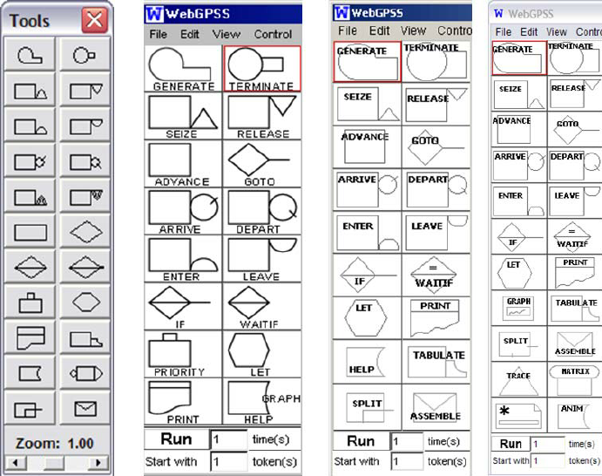

Slide 6
Problem
Simulation of a manufacturing shop
A machine tool in a manufacturing shop is a turning out parts at the rate of 1 every 5 minute. As they have finished the part go to an inspector who takes 4±3 to examine each one & rejects about 10% of the parts. Each part will represented by a transaction and the time unit selected for the problem will be 1 min.

Slide 7
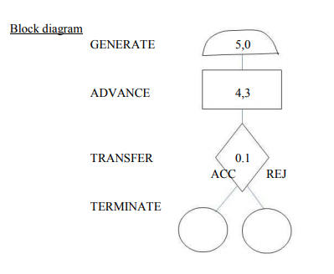

Slide 8
GPSS Code
GENERATE 5,0 create parts
ADVANCE 4,3 inspect parts
TRANSFER 0.1,AAC,REJ select or reject
TERMINATE 1 accepted path
TERMINATE 1 Rejected path
START 1000 Run for 1000 Parts

Slide 9
FACILITIES AND STORAGES
There are two types of permanent entities defining GPSS to represent system equipment.
Facilities and
Storages.
A facility is defined as an entity that can be engaged by a single transaction at a time like tollgate (gate where charge is collected).
A storage is defined as an entity that can be occupied by many transactions at a time up to predetermined limit.
e.g.- in transportation system, vehicle is transaction, a toolbox in a vehicle may be considerable as a facility and a road as a storage.

Slide 10
GPSSS-Facility and Storage blocks
Facility
Seize
Release
Storage
Enter
Leave

Slide 11
The seize block allows a transaction engage a facility if it is available.
The RELEASE block allows a transaction to disengage the facility.
An ENTER block allow a transaction to occupy a space in a storage if it is available and the leave blocks allows it to give up the space ( free the space).
In previous model inspection is a facility.

Slide 12
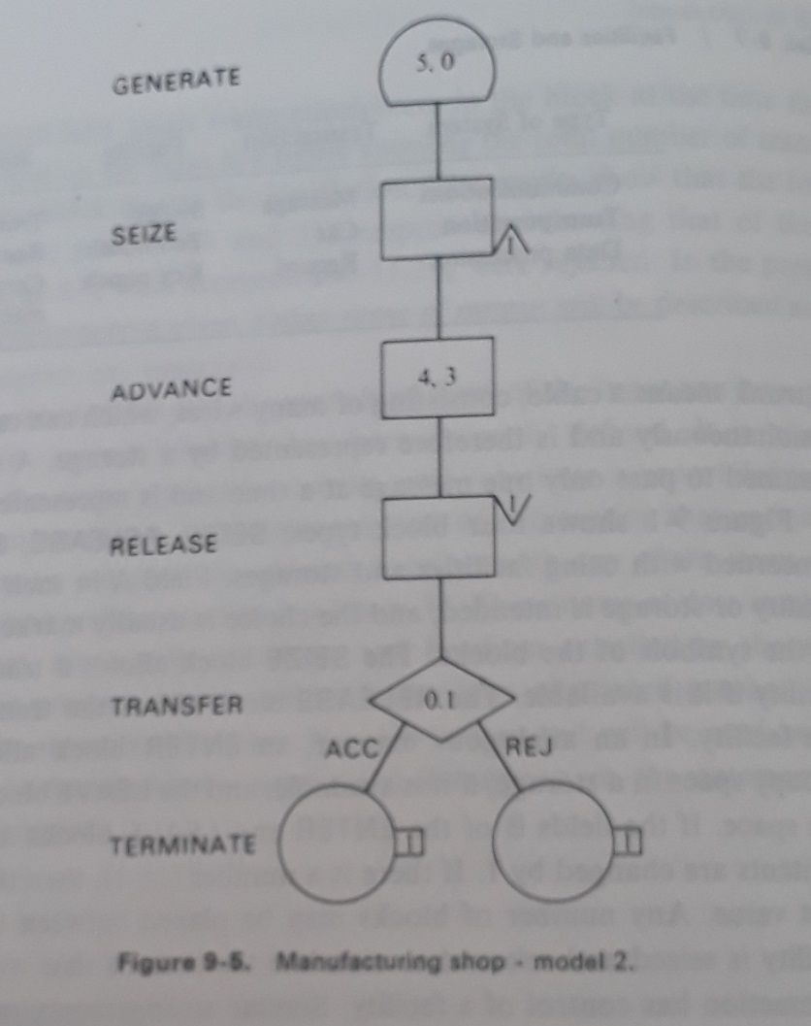

Slide 13
Introduction to SIMSCRIPT
SIMSCRIPT is a very widely used language for simulating discrete systems.
SIMSCRIPT is a free-form, English-like general-purpose simulation language conceived by Harry Markowitz and Bernard Hausner at the RAND Corporation in 1963.
It was implemented as a Fortran preprocessor on the IBM 7090 and was designed for large discrete event simulations. It influenced Simula.
Though earlier versions were released into the public domain, SIMSCRIPT was commercialized by Markowitz's company, California Analysis Center, Inc., which produced proprietary versions SIMSCRIPT I.5 and SIMSCRIPT II.5.

Slide 14
SIMSCRIPT System Concept
The system to be simulated is considered to consist of entities having attributes that interact with activities.
Temporary entities: The entities that are created and destroyed during the execution of a simulation.
Permanent entities: These entities remain during the run.
Sets: Entities can form sets.
Event routine: Each type of event is described by an event routine, each of which is given a name and programmed as a separate closed subroutine.
Endogenous (or internal) event: It arises from actions within the system.
Exogenous (or external) event: It arises from actions in the system environment.

Slide 15
SIMSCRIPT Program
SIMSCRIPT program structure consists of
Entities
Permanent
Temporary
Sets
Event routines

Slide 16
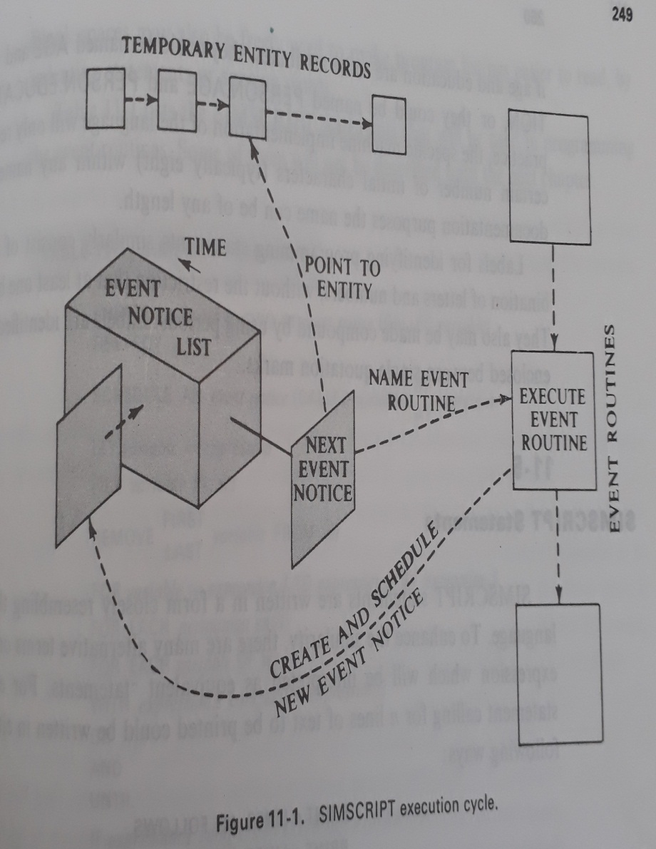
Organization of a SIMSCRIPT Program
The general manner in which the simulation proceeds is illustrated in the following figure.
The event notices are filed in chronological order.
When all events that can be executed at a particular time have been processed, the clock is updated to the time of the next event notice and control is passed to the event routine identified by the notice.
Each event notice records the time the event is due to occur and the event routine that is to execute the event.
If the event executed by a routine results in another event, either at the current clock time or in the future, the routine must create a new event notice and file it with the other notices.

Slide 17
Names and Labels:
All the entities and attributes should be given names.
Names: Names may consist of any combination of letters and digits provided there is at least one letter. Period (“.”) can be used.
Example: AGE, AB12, PERSON.AGE ® All are valid.
Labels: Labels are used for identifying programming statements similarly consists of any combination of letters and numbers. Period (“.”) can be used. Labels are identified by being enclosed between single quotation marks.
Example: ‘LABEL1’, ‘AB12’, ‘1234’ ® All are valid.’

Slide 18
SIMSCRIPT statements:
# Print statements:
PRINT n LINES AS FOLLOWS
PRINT n LINES THUS
# Print with the values of a variable:
PRINT n LINES WITH X AND Y LINE THIS
# Three digit integer * * *, Four digit real number with one decimal place would be indicated by * * * .*

Slide 19
Defining the System:
# Preamble section: This section defines the system structure and establishes the conditions under which the simulation will be run.
# Variables type: Real, Integer, Alphabetical
REAL, INTEGER, ALPHA, TEXT
Text Used for process character strings.
NORMALLY, MODE IS INTEGER (or ALPHA)

Slide 20
# Global variable: Global variable (that is available to all routines) or system variable.
[ They are in the normal mode]
THE SYSTEM HAS X AND Y
[To separate items we can use commas ( ,) or the word AND (or both)]
# If we need to define variable other than normal mode. We use DEFINE statement.
DEFINE name1, name2, ….., AS INTEGER VARIABLS
[If define does not use MODE then default normal mode is used.]

Slide 21
# The permanent entities, temporary entities and event notice are defined in lists, following the statements
PERMANEMT ENTITIES
TEMPORARY ENTITIES
EVENT NOTICES
Example: TEMPORARY ENTITIES
EVERY entity HAS attr1 AND attr2 …..
[80 characteristics line]
EVENT NOTICES
EVERY X HAS A attr1 A ……
# If no specified attribute is used other than the system’s attributes (data)
Then: EVENT NOTICES INCLUDE …………

Slide 22
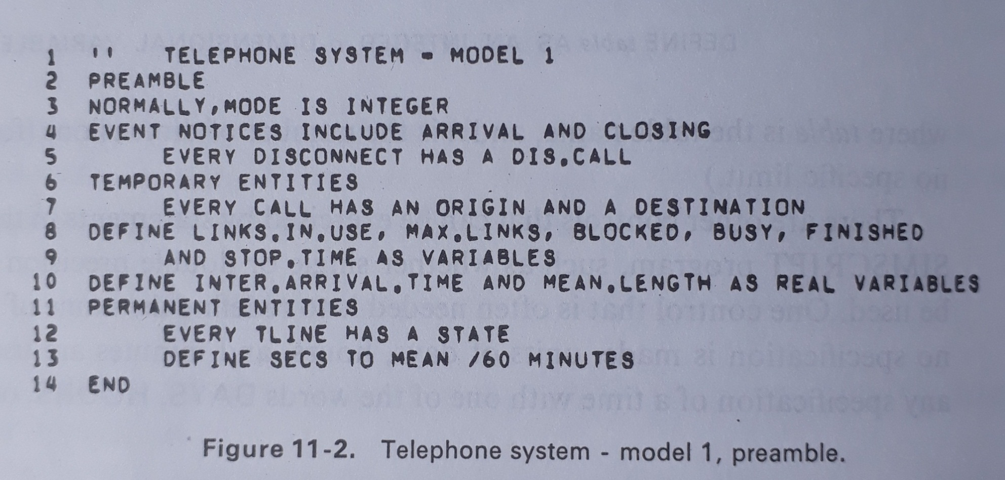
Defining the Telephone System Model

Slide 23
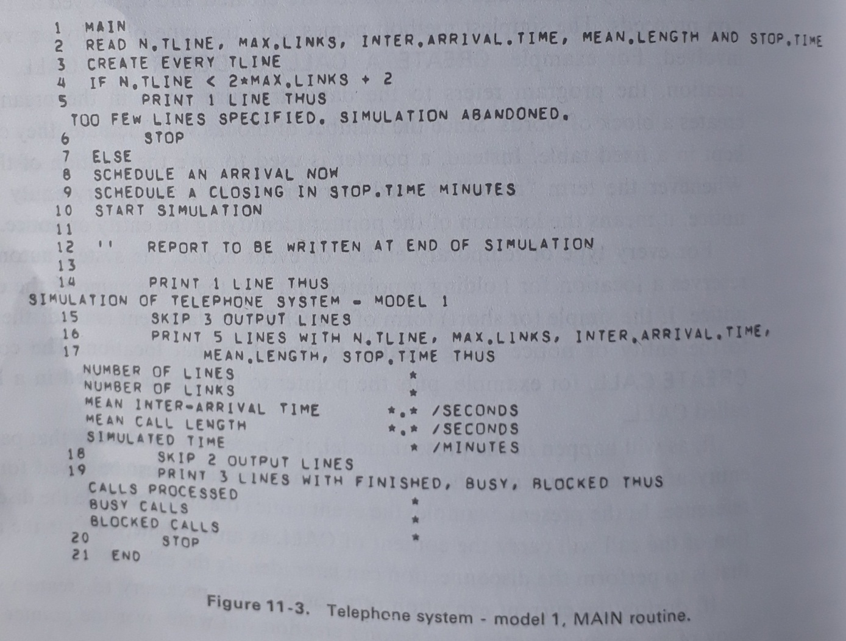

Slide 24
Assignment
What is GPSS? Explain with example.
Explain about the two permanent entities-facility and storage blocks with suitable example.
Explain the organization of SIMSCRIPT program with example of telephone system.
Draw GPSS diagram for the following problem.
A machine tool in a manufacturing shop is a turning out parts at the rate of 1 every 5 minute. As they have finished the part go to an inspector who takes 4±3 to examine each one & rejects about 10% of the parts. Each part will represented by a transaction and the time unit selected for the problem will be 1 min.

Slide 25
Draw GPSS for above problem with two inspector.
A machine tool in a manufacturing shop is a turning out parts at the rate of 1 every 5 minute. As they have finished the part go to an inspector who takes 4±3 to examine each one & rejects about 10% of the parts. The rejected parts are sent back for further work. Reworking takes 15±3 minutes and does not involve the machine that originally made the parts. After correction, the parts are resubmitted for inspection. Each part will represented by a transaction and the time unit selected for the problem will be 1 min. Simulate for 1000 parts.

Slide 26
Workers come to a supply store at the rate of one every 5±2 minutes. Their requisitions are processed by one of two clerks who take 8±4 minutes for each requisition. The requisitions are then passed to a single storekeeper who fills them one at a time taking 4±3 minutes for each request. Simulate the queue of workers and measure the distribution of time taken for 1000 requisitions to be filled.

